Slide 1


Slide 2
How to create
Next-level
Learning materials

Slide 3
Research
Learning Basics
  The Biology of Learning
  How the Brain Works
  Techniques for Faster Learning
Learning & Instructional Design Principles
  Grabbing Attention Tactics
  Organisation and Sequence
  Selected Design Techniques
  NEXT STEPS
3. Trends & Technology
4. LM Evaluation Models
Best Practices Samples
xxx
Visual Suggestions
Welcome Page
Program Intro
Progress Map
Module intro page
Learn [Gold Content]
Extra Mile Content
Sprint Intro [decisions, processes, relationships]
Key Learnings Summary [infographics]
Do - Tools Page
Checklist
Award page/Congrats
Module Summary
Complementary pages [FAQ, dictionary, toolbox flashcards]

Slide 4
learning basics

Slide 5
Learning basics
The biology of learning
How the brain works
Faster learning techniques

Slide 6

Neuroplasticity
KEY POINTS
Neuroplasticity is the nervous system ability to change in response to experience. It can be passive or active. For people over 25 Y must be active
Learning is triggered – if you do something actively, the brain will respond even after 25
Neuroplasticity occurs during sleep but also during non-sleep-deep rest NSDR. The Gap learning effects open the door to neuroplasticity when you stop doing something for a moment
There is a protocol in applying the science of neuroplasticity to enhance depth and sped of learning

Slide 7

What to consider
ELEMENTS
FOCUS – hearing and seeing
REPETITIONS – as many as possible
ERRORS – Super Mario effect
RANDOM MICRO-RESTS – 10 sec pauses
RANDOM REWARDS + no-reward sessions
LEARNING LIMIT – 90 min sessions
NON-SLEEP-DEE-REST - 10-30 min post learning practice

Slide 8
Learning basics
The biology of learning
How the brain works
Faster learning techniques

Slide 9
How the brain works
KEY POINTS
The brain needs clear prioritisation and a dedicated time for a task
The 7 learning styles is a myth [Kinesthetic, Visual, Aural, Verbal, Mathematical, Interpersonal, Intrapersonal approach cannot guarantee any learning outcome]
Make waves between intense effort and equally intense recovery [focused and defused mode]
Chunk-bite the material and use distributed learning.
There are certain techniques for faster and deeper learning

Slide 10
What to consider
ELEMENTS
VARY effortful and easy moments
MIX UP THE PRACTICES to strengthen the knowledge
Use ELABORATION PRINCIPLE [Explain it in your own words and connect it to other wisdom. Connect it to something you already know.]
Optimize the three aspects of successful intelligence: analytical + creative + practical via DYNAMIC TESTING

Slide 11
Learning basics
The biology of learning
How the brain works
Faster learning techniques

Slide 12
Faster learning techniques
KEY POINTS
Interleaving is a learning technique that involves mixing different topics or forms of practice, in order to facilitate learning.
Change the blocked manner of studying: AAAABBBBCCCC , ABCABCABCABC, AABBCCAABBCC with interleaving approach: AAABBBCCCABC – mix topics at the end ACBABBBAACCC – random manner of topics ACBABBCAACCB – interleave in a partially random manner
When you reinforce your memories by testing them, they get much stronger than if you simply re-read a passage.
Activate different parts of the brain to maximize the effect of learning
Top techniques include: microlearning, spaced repetition and retrieval method

Slide 13
What to consider
ELEMENTS
MIX in old material with new material.
Use INTERLEAVING TOGETHER WITH OTHER LEARNING STRATEGIES - repeated retrieval practice, practice testing and even studying in different locations.
TEST THE USER ON ALL LEVELS: for a specific chapter, a whole unit, and your entire course
Recommended SPACING INTERVALS: repetitions on days 1, 10, 30, 60
RETRIEVAL ties the knot for memory: The Brain Dump method [10 min to write down ideas and concepts learned]

Slide 14
Learning and instructional
design principles

Slide 15
Learning and instructional design principles
Grabbing-attention tactics
Organisation and sequence
Selected Design techniques

Slide 16
Grabbing attention tactics
KEY POINTS
Comparing/combining old and familiar concepts to new and exciting ones helps with focus and retention.
Only 10% information we hear or read is retainable. However, when new information is paired with an image, retention skyrockets to impressive 60%.
The contrast between listening and reading comprehension showed more activation for listening comprehension
The increasing digitalization of our world has made it far too easy to swipe, click and look away from things because there is always something else to look at. Design with short attention spans in mind.

Slide 17
What to consider
ELEMENTS
Use VISUALS next to the reading content
Make the content SKIMMABLE
Start with QUESTIONS
Add UNPREDICTABLE SOUNDS AND SIGHTS that signal something new to engage the dopamine system and seek more

Slide 18
Learning and instructional design principles
Grabbing-attention tactics
Organisation and sequence
Selected Design techniques

Slide 19
Organisation and sequence
KEY POINTS
Mastery-based learning is an approach where the learners need to demonstrate a high level of understanding of one topic or subject before moving on to the next.
Tasks analysis is a technique that allows content sequencing in terms of expected outcomes in the learning process.
Elaborative Sequence - from simple and general elements to more complex and detailed
The summary includes a revision of the content; the synthesis shows the relationships between the elements
Merrill’s First Principles of Instruction – include real-world problem solving

Slide 20
What to consider
ELEMENTS
Incorporate the MASTERY-BASED LEARNING’s factors:
  Clear and specific learning objectives
  Precise mastery thresholds meaning what exactly should learners know
  Make learners display mastery, e.g., through quizzes, tests
  Make teachers assess learners’ knowledge/immediate feedback mechanism
  Display the data
TASKS ANALYSIS process:
  Determine the task (skill to learn)
  Sub-tasks: determine the possible components
  Sequence subtasks or sub skills, from the simplest to the most complex.
Start with GENERAL VIEWPOINT, then introduce the COMPLEXITY, finally add SUMMARY AND A SYNTHESIS

Slide 21
Learning and instructional design principles
Grabbing-attention tactics
Organisation and sequence
Selected Design techniques

Slide 22
Selected design techniques
KEY POINTS
The Multimedia Principle: people learn better from words and pictures than from words alone.
The Spatial Contiguity Principle: people learn better when corresponding words and pictures are presented near one another. This can refer to pages, screens, and so on.
The Temporal Contiguity Principle: people learn better when corresponding words and pictures are presented simultaneously, not successively.
Instructional design should contextualise information
Instructional design should proceed at an efficient pace

Slide 23
What to consider
ELEMENTS
Utilize MULTIMEDIA
POSITION text (labels, captions, descriptions, etc.) close to the image it describes
Use VARIED FORMATS
Use multiple VISUAL EXAMPLES
Use CLEAR, ORGANIZED FORMAT
When to use GRAPHICS:
  Portray emotions – use scenario approach, ex. add characters experience emotions
  Visualise data – diagrams, graphs, charts
  Identify parts and components – labeled illustrations, cutaways
  Trace motion or object’s path – movement through lines and arrows
  Geography and statistical data – quantitative information, distribution of variables

Slide 24
Add-on
Trends and technology

Slide 25
Learning Trends and technology
WHAT
Create Opportunities for Interaction
HOW
Consider interactive lessons that they can click through. Better yet, supplement lessons with self-check questions, click-to-reveal notes with supplemental materials, and other strategies for letting students check their progress, interact with the content, and more.

Slide 26
Learning Trends and technology
WHAT
New technology: AI, VR and yet to come…
HOW
Newest technology enters the learning field:
Flexible OLED-based displays that can be rolled like paper
Level-upped biometrics
Eye-tracking technology
Simulation learning allowing users to practice critical work skills in a controlled environment

Slide 27
Learning Trends and technology
WHAT
Social learning
HOW
Create Forums, Chatrooms, and File-sharing options among learners and trainers.

Slide 28
Learning Trends and technology
WHAT
Integrating LIFOW (Learning In the Flow Of Work) resources
HOW
Learning in the flow of work involves accessing, quickly and easily, an answer or a short piece of learning content while you're working.
Platforms are already doing it:
Microsoft introduced Viva
Skillsoft [SurveyMonkey and InVision] partners with Monday.com and Todoist to share product prototypes, create quizzes and flashcards, manage lists and add live polling to meetings

Slide 29
Learning Trends and technology
WHAT
Learning for All - Accessibility Considerations in eLearning
HOW
In digital learning, accessible content is designed and developed in a way that allows people with special needs to find, understand, and navigate learning elements with ease
Disabilities can be visual, auditory, physical, speech-related, cognitive, learning, or neurological.

Slide 30
What to adopt
resume

Slide 31



STRUCTURE
DESIGN
RULES

Slide 32
RULES
STRUCTURE
DESIGN
Insert video/gif/or simple timer to focus the users intentionally when they are out of our control.
Work hard and then reward.
Add TIME TO READ time for the LEARN section.
Add suggested best time to do this.
ADD expectancy – show WHY do or learn sth to boost motivation
Manage focus by using white noise.
Include recommended playlist
Insert random 10 sec. pauses during the Sprint.
Give random rewards. Boost the gamification mode.
Introduce different visualization practices to stimulate learning confidence.
Keep each sprint 90 min long and communicate the length at the beginning.
„Translate“ each Learn part in different formats – text, MP3, notes, animated drawings/explanatory video.
After 60 min – NSDR activity
Use examples from different industries.
Create exercises thinking from a different perspective.

Slide 33

RULES
STRUCTURE
DESIGN
Insert video/gif/or simple timer to focus the users intentionally when they are out of our control.

Slide 34
RULES
STRUCTURE
DESIGN
Work hard and then reward.
Add TIME TO READ time for the LEARN section.
Add suggested best time to do this.
ADD expectancy – show WHY do or learn sth to boost motivation

Slide 35
RULES
STRUCTURE
DESIGN
Manage focus by using white noise.
Include recommended playlist
[Partnership with a platform?]

Slide 36
RULES
STRUCTURE
DESIGN
Insert random 10 sec. pauses during the Sprint.

Slide 37
RULES
STRUCTURE
DESIGN
Give random rewards. Boost the gamification mode.

Slide 38
RULES
STRUCTURE
DESIGN
Introduce different visualization practices to stimulate learning confidence.

Slide 39
RULES
STRUCTURE
DESIGN
Keep each sprint 90 min long and communicate the length at the beginning.

Slide 40
RULES
STRUCTURE
DESIGN
„Translate“ each Learn part in different formats – text, MP3, notes, animated drawings/explanatory video.

Slide 41
RULES
STRUCTURE
DESIGN
After 60 min – NSDR activity – incorporate with an external tool???

Slide 42
RULES
STRUCTURE
DESIGN
Use examples from different industries.
Create exercises thinking from a different perspective.

Slide 43
What to adopt
resume

Slide 44
RULES
DESIGN
STRUCTURE

Slide 45

RULES
STRUCTURE
DESIGN
Start with a problem. Introduce a case study and put a question that the user must answer after the unit. Next, reveal the current solution. Then, stimulate the user to use notes to suggest 3 more possible ways to solve this problem.
Action-oriented specific outcome.
Introduce case study at the beginning of each sprint. Start with a question.
Include working on real projects, analyzing case studies, testing hypotheses, solving actual problems.
The key questions we have in the Workbook to be presented after the GOLD content and before the checklist:
Quiz like – one question at a time. RANDOMISE.
Clear WRONG signal to activate the TRY AGAIN mode.
That would be the PASS, the GATE to the next part… that unlocks the Extra Mile content.
Incorporate quick tests win an immediate feedback mechanism. Wrong signal. Try again. Wrong signal. Try again. Wrong signal. Celebrate.
Include Test yourself option.
Create a 30-days program to structure the EXTRA MILE recommended sources. Feature to unlock in a selected time frame.
Implement Notes section after each Gold material to enhance practical thinking via the retrieving method.

Slide 46
RULES
STRUCTURE
DESIGN
Start with a problem. Introduce a case study and put a question that the user must answer after the unit.
Next, reveal the current solution.
Then, stimulate the user to use notes to suggest 3 more possible ways to solve this problem.
Action-oriented specific outcome.

Slide 47
RULES
STRUCTURE
DESIGN
Introduce case study at the beginning of each sprint. Start with a question.
Include working on real projects, analyzing case studies, testing hypotheses, solving actual problems.

Slide 48
RULES
STRUCTURE
DESIGN
The key questions we have in the Workbook to be presented after the GOLD content and before the checklist:
Quiz like – one question at a time. RANDOMISE.
Clear WRONG signal to activate the TRY AGAIN mode.
That would be the PASS, the GATE to the next part… that unlocks the Extra Mile content.

Slide 49
RULES
STRUCTURE
DESIGN
Incorporate quick tests win an immediate feedback mechanism.
Wrong signal. Try again. Wrong signal. Try again. Wrong signal. Celebrate.

Slide 50
RULES
STRUCTURE
DESIGN
Include Test yourself option.

Slide 51
RULES
STRUCTURE
DESIGN
Create a 30-days program to structure the EXTRA MILE recommended sources.
Feature to unlock in a selected time frame.

Slide 52
RULES
STRUCTURE
DESIGN
Implement Notes section after each Gold material to enhance practical thinking via the retrieving method.

Slide 53
What to adopt
resume

Slide 54
RULES
STRUCTURE
DESIGN

Slide 55
RULES
STRUCTURE
DESIGN
PRESENT CONTENT IN MULTIPLE WAYS TO TARGET DISABILIITES
All non-text content should be paired with a text alternative. [‘Alt tags’ for images written to clearly describe what the image depicts; Videos with captions describing the audio track; Audio with a text transcript; Form inputs labeled]
Videos and other visual multimedia content such as infographics, GIFs, and animations should be paired with a description.
A text description of the content, for screen readers
An audio description
VISUAL STYLING DOES MATTER IN MAKING CONTENT CLEAR AND DISCERNIBLE FOR USERS WITH LIMITED VISION OR WITH LEARNING DISABILITIES
Avoid using color on its own to distinguish or organize content, as color-blind users might have difficulty discerning differences.
Ensure sufficient contrast—dark and light—between visual elements.
ORGANIZE, STRUCTURE, AND MAKE CONTENT CLEAR TO TARGET DISABILITIES
Don’t just bold titles and headers—use the correct ‘styles’ to organize and identify different levels of headings: H1, H2, H3, H4.
Don’t use hyphens or other characters to manually mark up lists—use the bulleted or numbered list styles.
Don’t use tables to style content—but do use them if you are presenting an actual table of data.
Don’t use colored or highlighted text to make passages stand out—use bold for importance, italic for emphasis, and blockquote for call-outs or quotes.
Communicate the pattern the user will execute at the beginning – with icons READ-DO, etc
Create a toolbox section [Appendix] with tag that each user can easily access and use. Link it throughout the PDF to make faster connections.
Create and use flashcards for the tools or for the explanation of an idea, principle.
Repeat content in different formats
Text
Graphics resume + key points
Video
Reduce the Number of Things in the Visual. This may mean removing unrelated items.
One accent at a time. Translate explanatory content into icons and minimize it on the page.
Using simplified visuals that are easier to process mentally. Reduce visual noise, use silhouetted figures, make use of icons.
Add Info boxes on a pop-up base with short scientifically based explanation why we are using a target or white noise or other technique.
Intro page with the steps + Time for each of them + [ex. mini timer]
Summary – visual navigation on which part you are currently.

Slide 56
RULES
STRUCTURE
DESIGN
Communicate the pattern the user will execute at the beginning – with icons READ-DO, etc
Intro page with the steps +
Time for each of them + [ex. mini timer]
Summary – visual navigation on which part you are currently.

Slide 57
RULES
STRUCTURE
DESIGN
Create a toolbox section [Appendix] with tag that each user can easily access and use. Link it throughout the PDF to make faster connections.

Slide 58
RULES
STRUCTURE
DESIGN
Create and use flashcards for the tools or for the explanation of an idea, principle.

Slide 59
RULES
STRUCTURE
DESIGN
Repeat content in different formats
Text
Graphics resume + key points – select topics to put the EXTRA MILE content there - ranked
Infographics to summarise each sprint

Slide 60
RULES
STRUCTURE
DESIGN
Reduce the Number of Things in the Visual. This may mean removing unrelated items.
One accent at a time. Translate explanatory content into icons and minimize it on the page.

Slide 61
RULES
STRUCTURE
DESIGN
Using simplified visuals that are easier to process mentally. Reduce visual noise, use silhouetted figures, make use of icons.

Slide 62
RULES
STRUCTURE
DESIGN
Add Info boxes on a pop-up base with short scientifically based explanation why we are using a target or white noise or other technique.

Slide 63
RULES
STRUCTURE
DESIGN
PRESENT CONTENT IN MULTIPLE WAYS TO TARGET DISABILIITES
All non-text content should be paired with a text alternative.
‘Alt tags’ for images written to clearly describe what the image depicts
Videos with captions describing the audio track
Audio with a text transcript
Form inputs labeled

Slide 64
RULES
STRUCTURE
DESIGN
PRESENT CONTENT IN MULTIPLE WAYS TO TARGET DISABILIITES
Videos and other visual multimedia content such as infographics, GIFs, and animations should be paired with a description.
A text description of the content, for screen readers
An audio description

Slide 65
RULES
STRUCTURE
DESIGN
PRESENT CONTENT IN MULTIPLE WAYS TO TARGET DISABILIITES
Visual styling does matter in making content clear and discernible for users with limited vision or with learning disabilities:
Avoid using color on its own to distinguish or organize content, as color-blind users might have difficulty discerning differences.
Ensure sufficient contrast—dark and light—between visual elements.

Slide 66
RULES
STRUCTURE
DESIGN
ORGANIZE, STRUCTURE, AND MAKE CONTENT CLEAR TO TARGET DISABILITIES
Don’t just bold titles and headers—use the correct ‘styles’ to organize and identify different levels of headings: H1, H2, H3, H4.
Don’t use hyphens or other characters to manually mark up lists—use the bulleted or numbered list styles.
Don’t use tables to style content—but do use them if you are presenting an actual table of data.
Don’t use colored or highlighted text to make passages stand out—use bold for importance, italic for emphasis, and blockquote for call-outs or quotes.

Slide 67
LM evaluation models

Slide 68
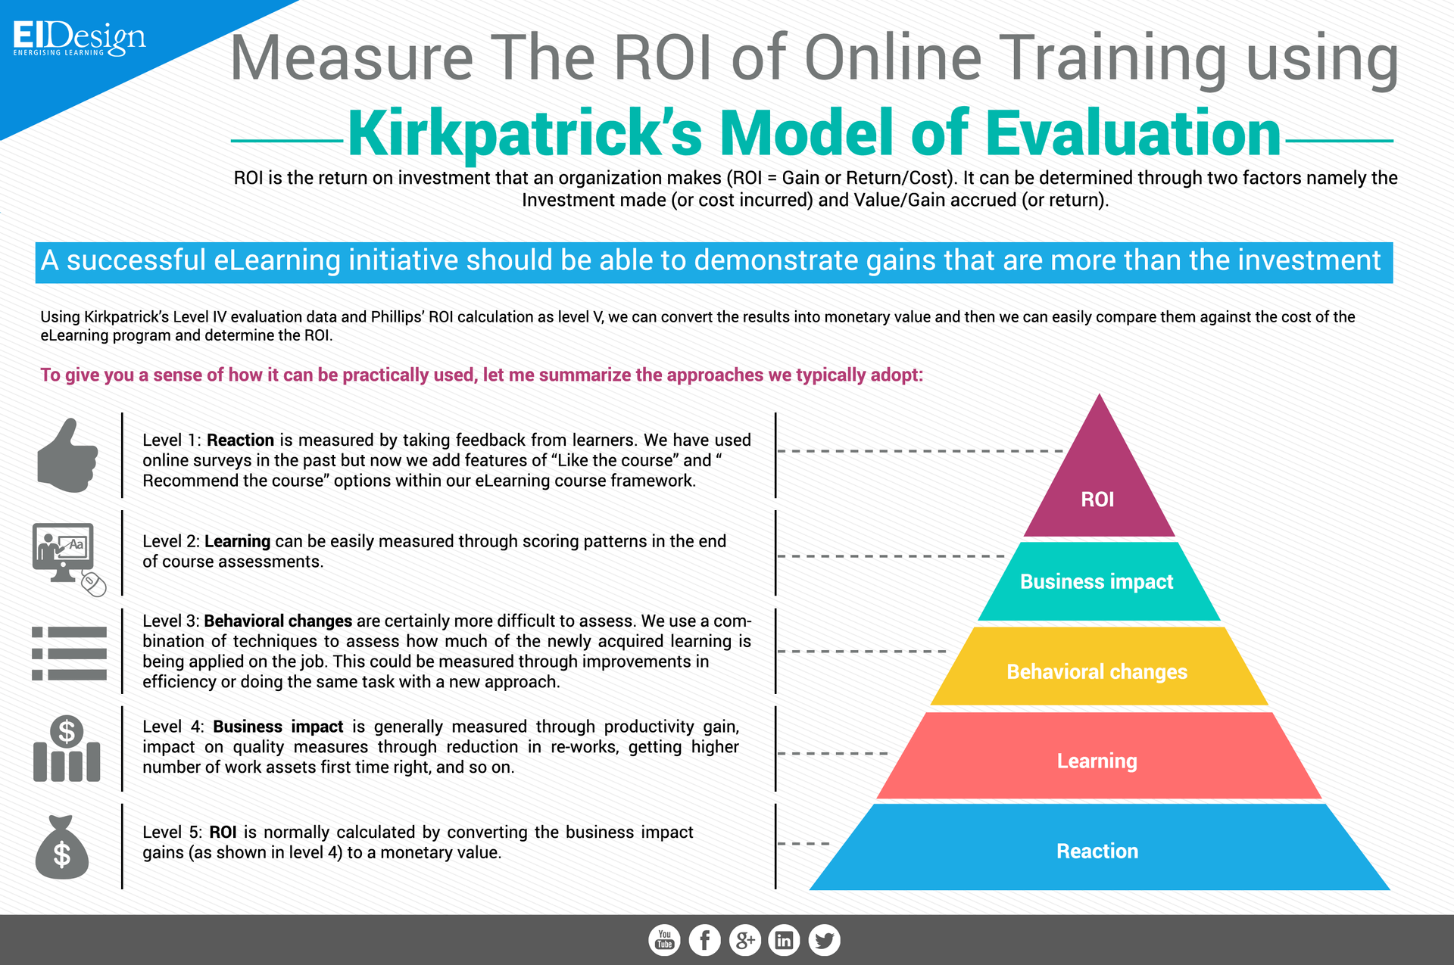
Kirkpatrick’s Four Levels of Training Evaluation

Slide 69
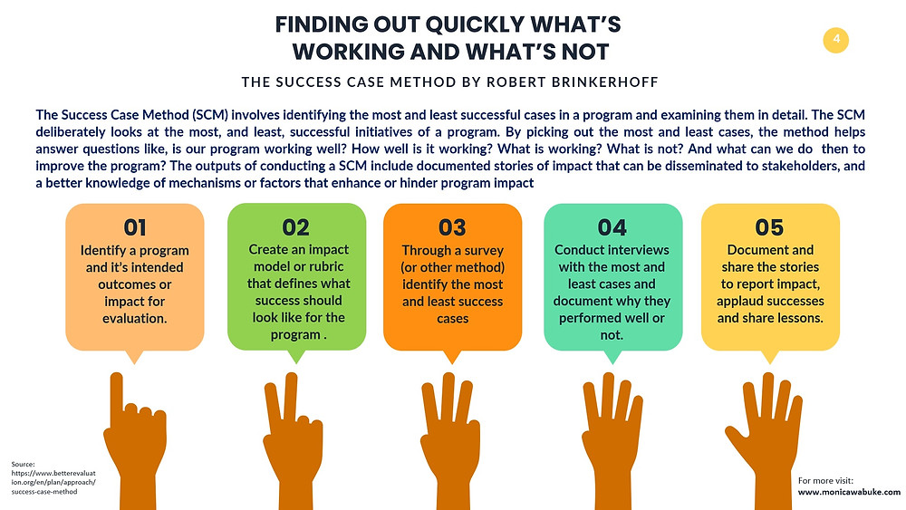
Brinkerhoff’s Success Case Method

Slide 70
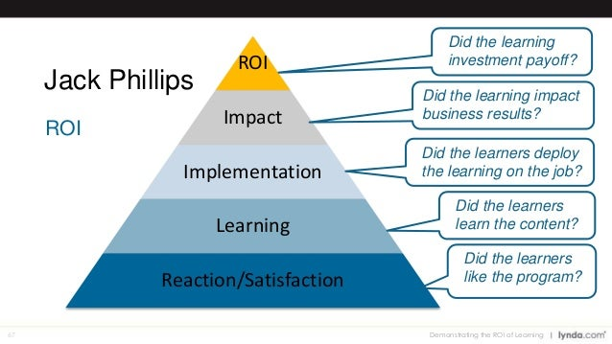
Philips ROI Methodology

Slide 71


